Slide 1
CSE431: Natural Language Processing
Rumor Detection on Social Media with Bi-Directional Graph Convolutional Networks
Tian Bian,^{1,2} Xi Xiao,¹ Tingyang Xu,² Peilin Zhao,² Wenbing Huang,² Yu Rong,² Junzhou Huang²
¹Tsinghua University, ²Tencent AI Lab
Paper Review By
Group - 10
[19101353] Mehzabin Sadat Aothoi
[19101497] Samin Ahsan
[18101668] Fardeen Ahmed

Slide 2
Abstract
Introduction
The rapid development of the Internet leads to rumors being circulated. Meanwhile, detecting rumors from such massive information in social media is becoming an arduous challenge. The two most crucial characteristics of rumors are propagation and dispersion. In this paper, the authors proposed a novel bi-directional graph model, named Bi-Directional Graph Convolutional Networks (Bi-GCN), to explore both characteristics.
Conventional Detection Methods:
Decision Tree (Castillo, Mendoza, and Poblete 2011)
Random Forest (Kwon et al. 2013)
Support Vector Machine (Yang et al. 2012)
Deep Learning Models:
Long Short Term Memory (LSTM)
Gated Recurrent Unit (GRU)
Recursive Neural Networks (RvNN)

Slide 3
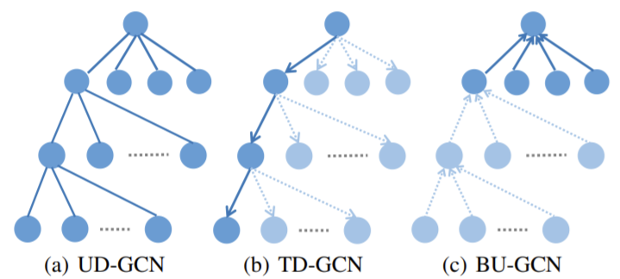
Convolutional Neural Network (CNN):
Can obtain the correlation features within local neighbors
Cannot handle the global structural relationships in graphs or trees
Not designed to learn high-level representations from structured data but Graph Convolutional Network (GCN) is
Bi-directional GCN (Bi-GCN):
Deals with both propagation and dispersion of rumors
Two parts: TD-GCN and BU-GCN
TD-GCN forwards information from the parent node of a node in a rumor tree to formulate rumor propagation
BU-GCN aggregates information from the children nodes of a node in a rumor tree to represent rumor dispersion
Then, the representations of propagation and dispersion pooled from the embedding of TD-GCN and BU-GCN are merged together through full connections
Enhance the influences from the roots of rumors
DropEdge is employed to avoid overfitting issues of our model

Slide 4
GNN-based fake news detection models
GNN-CL: Han, Yi, Shanika Karunasekera, and Christopher Leckie. "Graph neural networks with continual learning for fake news detection from social media." arXiv preprint arXiv:2007.03316 (2020).
GCNFN: Monti, Federico, Fabrizio Frasca, Davide Eynard, Damon Mannion, and Michael M. Bronstein. "Fake news detection on social media using geometric deep learning." arXiv preprint arXiv:1902.06673 (2019).
BiGCN: Bian, Tian, Xi Xiao, Tingyang Xu, Peilin Zhao, Wenbing Huang, Yu Rong, and Junzhou Huang. "Rumor detection on social media with bi-directional graph convolutional networks." In Proceedings of the AAAI Conference on Artificial Intelligence, vol. 34, no. 01, pp. 549-556. 2020.
UPFD-GCN: Kipf, Thomas N., and Max Welling. "Semi-supervised classification with graph convolutional networks." arXiv preprint arXiv:1609.02907 (2016).
UPFD-GAT: Veličković, Petar, Guillem Cucurull, Arantxa Casanova, Adriana Romero, Pietro Lio, and Yoshua Bengio. "Graph attention networks." arXiv preprint arXiv:1710.10903 (2017).
UPFD-SAGE: Hamilton, William L., Rex Ying, and Jure Leskovec. "Inductive representation learning on large graphs." arXiv preprint arXiv:1706.02216 (2017).

Slide 5
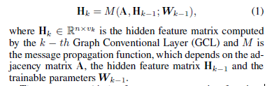
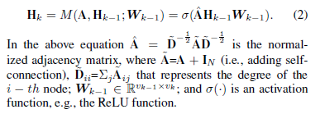

Preliminaries
Graph Convolutional Networks
Among all the existing works, GCN is one of the most effective convolution models, whose convolution operation is considered as a general ”message-passing” architecture as follows:
DropEdge
Novel method to reduce overfitting for GCN based models. The adjacency matrix after DropEdge, A’, is computed as below:

Slide 6
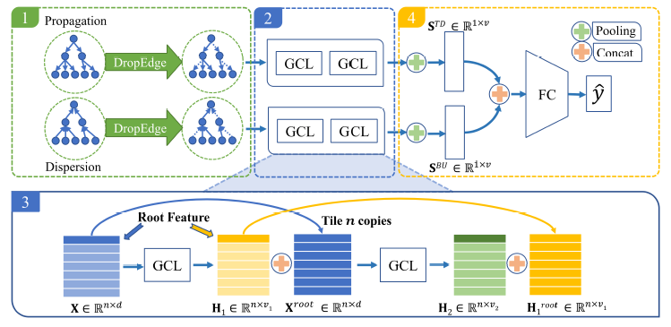
Bi-GCN Rumor Detection Model
An effective GCN-based method for rumor detection based on the rumor propagation and the rumor dispersion, named as Bi-directional Graph Convolutional Networks (Bi-GCN).
Learn suitable high-level representations from both rumor propagation and rumor dispersion
Two-layer 1stChebNet are adopted as the fundamental GCN components
1 Construct Propagation and Dispersion Graphs
We construct the propagate structure <V,E> for a rumor event Ci
A only contains the edges from the upper nodes to the lower nodes
At each training epoch, p percentage of edges are dropped via Eq. (3) to form A’, which avoid penitential overfitting issues
TD-GCN, the adjacency matrix is represented as A^{TD} = A’. Meanwhile, for BU-GCN, the adjacency matrix is A^{BU} = A’^{T}.

Slide 7

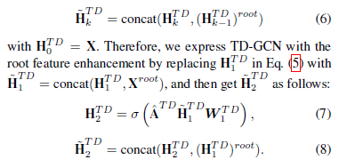
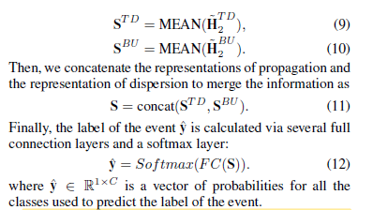
2 Calculate the High-level Node Representations
By substituting A^{TD} and X to Eq. (2) over two layers, we write the equations for TD-GCN as:
where H₁^{TD} ∈ R^{nxv1} and H₂^{TD} ∈ R^{nxv2} represent the hidden features of two layer TD-GCN. W₀^{TD} ∈ R^{dxv1} and W₁^{TD} ∈ R^{v1xv2} are the filter parameter matrices of TD-GCN.
3 Root Feature Enhancement
For TD-GCN at the k-th GCL, we concatenate the hidden feature vectors of every nodes with the hidden feature vector of the root node from the (k - 1)-th GCL to construct a new feature matrix as:
H₁^{BU} and H₂^{BU} , are obtained in the same manner.
4 Representations of Propagation and Dispersion for Rumor Classification
We employ mean-pooling operators to aggregate information from these two sets of the node representations. It is formulated as:

Slide 8
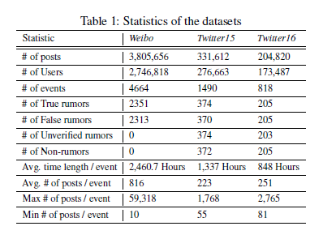
Experiments
Evaluate the performance of the proposed Bi-GCN method with other baseline methods
Investigate the effect of each variant of the proposed method
Examine the capability of early rumor detection for both the proposed and compared methods
Datasets
Weibo
Twitter15
Twitter16
2 binary labels:
False Rumor(F)
True Rumor(T)
4 binary labels for both:
Non-Rumor(N)
False Rumor(F)
True Rumor(T)
Unverified Rumor(U)

Slide 9
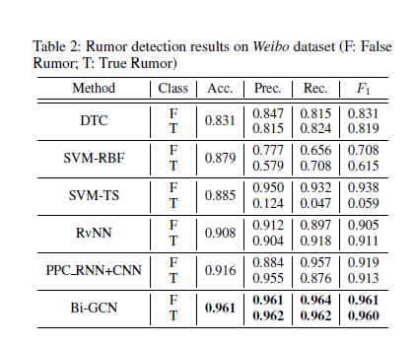
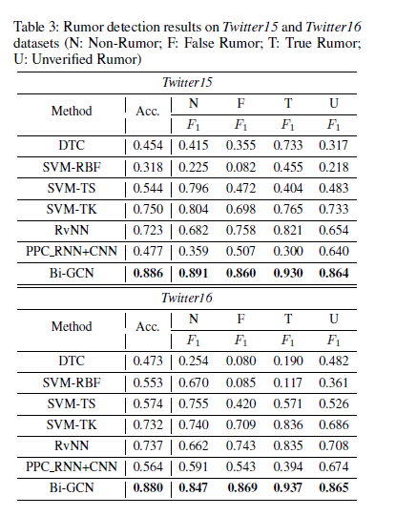
Experimental Setup
Compare Bi-GCN with some advanced baseline methods such as:
DTC
SVM-RVF
SVF-TS
SVM-TK
RvNN
PPC_RNN+CNN
DTC and SVM-based models are implemented with scikitlearn; PPC RNN+CNN with Keras; RvNN and Bi-GCN with Pytorch
For fair comparison, datasets are randomly split into 5 parts and 5-fold cross validation is conducted
For the Weibo dataset, the Accuracy (Acc.) is evaluated over the two categories and Precision (Prec.), Recall (Rec.), F1 measure (F1) on each class. For the two Twitter datasets, Acc. is evaluated over the four categories and F1 on each class

Slide 10
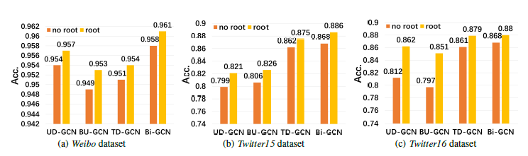
Performance
Among baseline algorithms, deep learning methods perform better
Bi-GCN outperforms PPC_RNN+CNN across all performance metrics
Bi-GCN is significantly superior to RvNN
Ablation study
BiGCN, TD-GCN, BU-GCN, and UD-GCN outperforms their variants without the root feature enhancement, respectively
TD-GCN and BU-GCN can not always achieve better results than UD-GCN, but Bi-GCN is always superior to UD-GCN, TD-GCN and BU-GCN
Even the worst results in Figures 3 are better than those of other baseline methods in Table 2 and 3 by a large margin
Bi-GCN is compared with TD-GCN(Top Down), BU-GCN(Bottom Up), UD-GCN(Undirected) and their variants without the root feature enhancement.

Slide 11
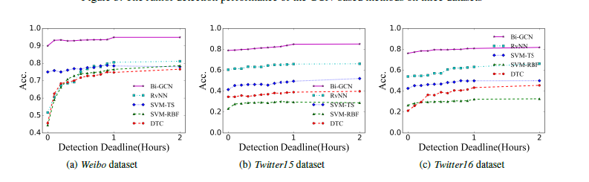
Early Rumor Detection
Conclusion
Detect rumor at early stage of propagation
Set up a series of detection deadlines and use only posts released before the deadlines
Bi-GCN method reaches relatively high accuracy at a very early period
Performance of Bi-GCN is remarkably superior to other models at each deadline
GCN based approaches outperform the state-of-the-art approaches by a large margin and Bi-GCN in particular has the best performance

Slide 12
Thank You!

